Slide 1
Lecture Foundations of Artificial Intelligence Part 11 – Deep Learning (Part 1)
Torsten Zesch
Language Technology Lab
Universität Duisburg-Essen
Notes:
Willkommen zur Vorlesung Grundlagen der künstlichen Intelligenz, oder auch Wissensrepräsentation.

Slide 2
Reading
Mandatory:
Ian Goodfellow, Yoshua Bengio, Aaron Courville:
Deep Learning, Introduction, p.1-26 http://www.deeplearningbook.org/contents/intro.html
Optional:
Tariq Rashid: Make your own neural network https://www.amazon.com/Make-Your-Own-Neural-Network-ebook/dp/B01EER4Z4G/
Very gentle step-by-step introduction

Slide 3
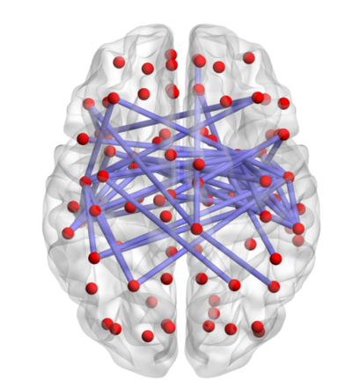
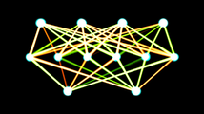
Deep Learning
Subfield of machine learning
Neural networks: a brain-inspired metaphor for a computational model
https://upload.wikimedia.org/wikipedia/commons/0/0e/Brain_network.png
https://upload.wikimedia.org/wikipedia/commons/thumb/3/32/Single-layer_feedforward_artificial_neural_network.png/214px-Single-layer_feedforward_artificial_neural_network.png
Notes:
Warum sind neuonale Netzwerke so populär? Catchy brain metaphor, sehr gute Ergebnisse

Slide 4
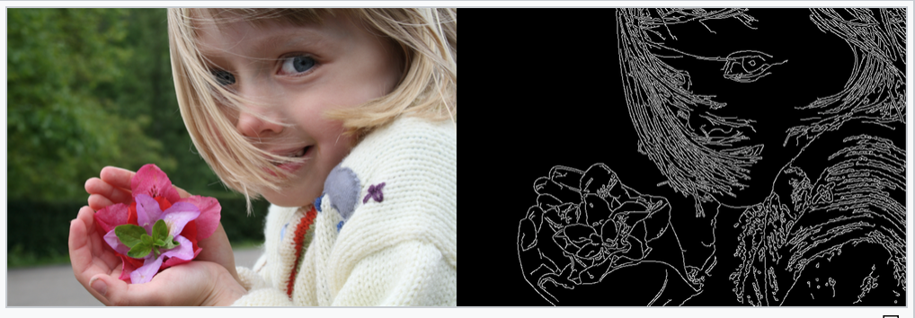
Classical vs. Deep Learning
Analyze the data
Develop good features → requires domain knowledge → very tedious and time-consuming → very often, features cannot be reused for another task

Slide 5
Classical vs. Deep Learning
Analyze the data
Develop good features → requires domain knowledge → very tedious and time-consuming → very often, features cannot be reused for another task
Idea: automate the feature development
→ start with very basic low-level representations → identify relevant patterns in the data

Slide 6
Learned Representations
Source: https://becominghuman.ai/what-is-deep-learning-and-its-advantages-16b74bc541a1 and
Lee et al. (ICML 2009)
Notes:
Bildgröße sollte eigentlich normiert sein.

Slide 7
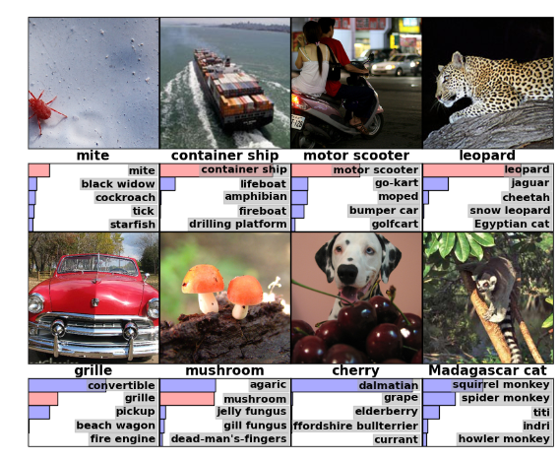
DL Example: Object Recognition
Alex Krizhevsky, Ilya Sutskever and Geoffrey E. Hinton (2012): ImageNetClassification With Deep Convolutional Neural Networks
Figure 4:

Slide 8
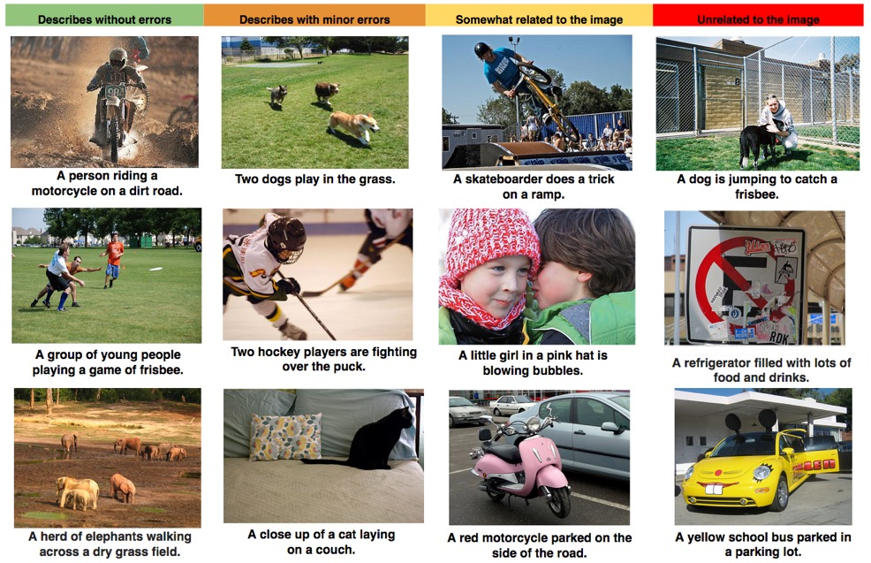
DL Example: Image Description
GoogLeNet 2014: http://googleresearch.blogspot.de/2014/09/
Building deeper understanding of images
Notes:
http://googleresearch.blogspot.de/2014/09/building-deeper-understanding-of-images.html#uds-search-results

Slide 9
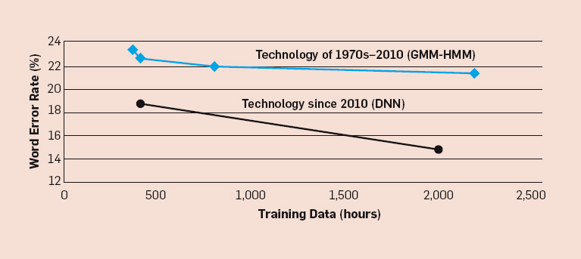
Speech Recognition
Xuedong Huang, James Baker, Raj Reddy: A Historical Perspective of Speech Recognition
Notes:
Word error rate 22% = 1 out of 5 words
More training data did not help much

Slide 10
What happened in 2010?
Abdel-rahman Mohamed, Dong Yu, Li Deng (2010): Investigation of Full-Sequence Training of Deep Belief Networks for Speech Recognition
Notes:
Due to Deep Learning

Slide 11
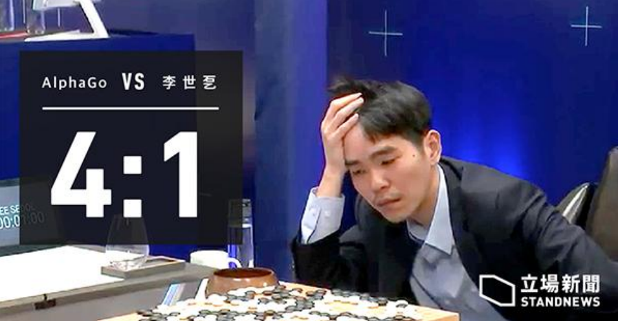
Deep Learning Breakthroughs

Slide 12
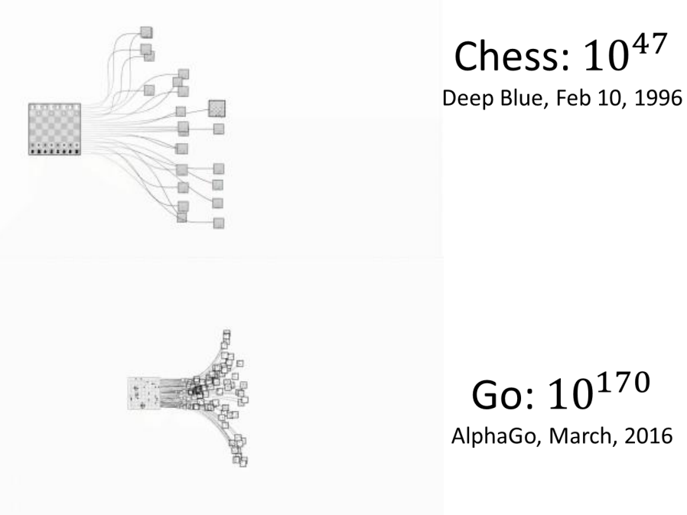
Deep Learning Breakthroughs

Slide 13
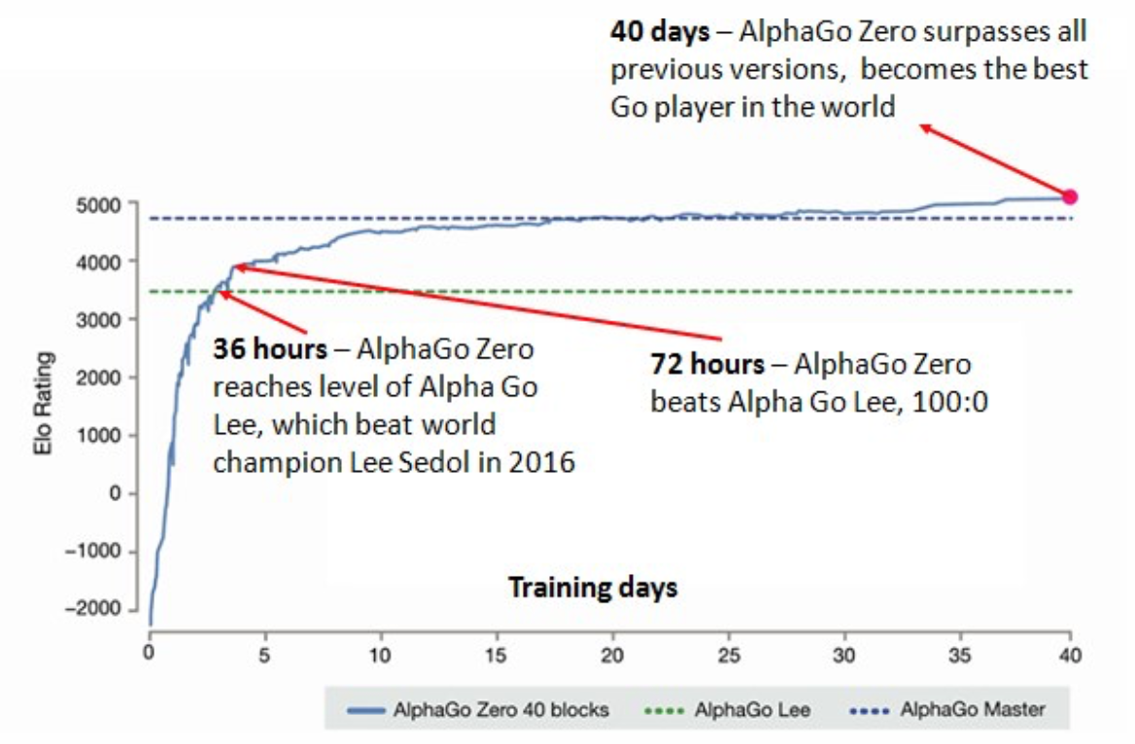
Alpha Zero

Slide 14
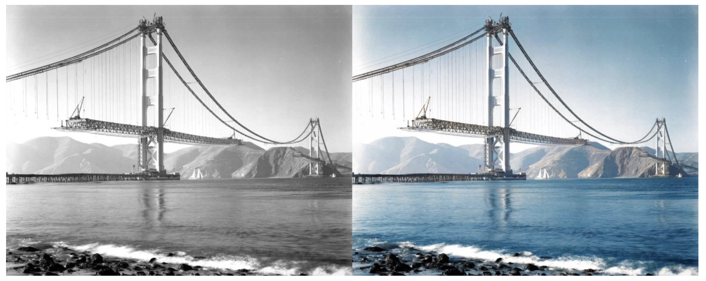
Cool Projects
https://github.com/jantic/DeOldify

Slide 15
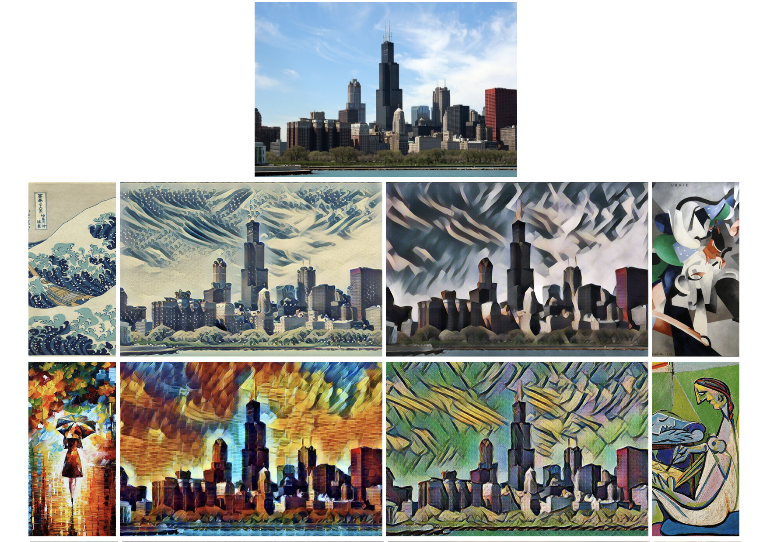
Cool Projects
https://github.com/lengstrom/fast-style-transfer

Slide 16
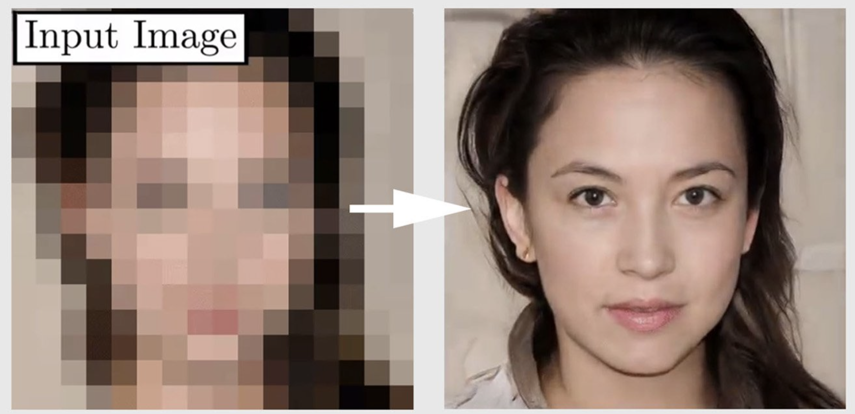
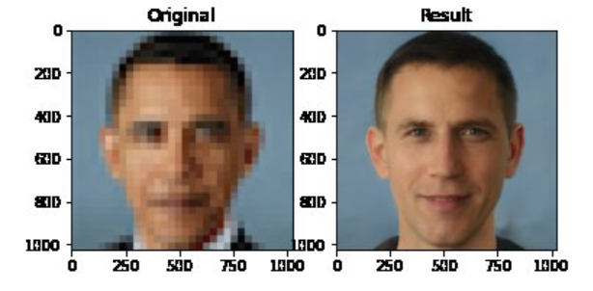
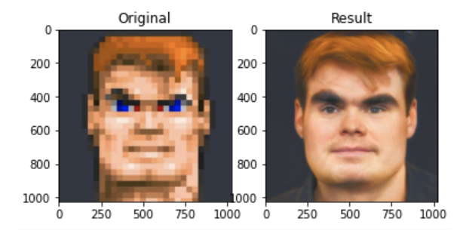
… but attention

Slide 17
Why are neural networks so powerful?
Non-linear activation functions
Most problems do not follow linear relationships
Hidden layers
Reduce feature engineering
Learn directly from low-level input
Able to learn patterns in the data that humans were not able to anticipate
Powerful architectures
Recurrent neural networks, LSTMs, convolutional networks, etc.

Slide 18
Why is working with neural networks so hard?
You need
a lot of data and a lot of computing power
Understanding of which network architecture works best for your problem
a lot of time/money for parameter optimization
As you don’t design the features, the outcome is really hard to interpret. What did the network learn?

Slide 19
Neural networks:
a retrospective
Notes:
Beispiel für Business Analytics Studenten

Slide 20
History of Deep Learning
Early booming (1950s – early 1960s)
Rosenblatt (1958) , Perceptron
Widrow and Hoff (1960, 1962)
Learning was rule-based on gradient descent
Setback (mid 1960s – late 1970s)
Serious problems with perceptron model (Minsky’s book 1969) → It can’t even represent simple functions
Renewed enthusiasm (1980s)
New techniques (backpropagation for “deep nets”)
Notes:
Reference: www.deeplearningbook.org
Unsupervised pre-training will be explained later

Slide 21
Deep Learning
Out-of-fashion again (1990s – mid 2000s)
Other techniques were considered superior and more understandable
Support Vector Machines, Integer linear programming, etc.
Neural networks were so out of fashion some good CS journals immediately rejected papers on neural networks without review (as reported by Geoffrey Hinton, and others)
Played virtually no role in top NLP conferences
Since mid 2000: huge progress for “deep learning”
Hinton and Salakhutdinov (2006): one can actually train deep nets
Since 2013: Veritable hype in NLP, mostly due to word2vec
Notes:
Reference: www.deeplearningbook.org
Unsupervised pre-training will be explained later

Slide 22
Connectionist vs. Symbolic

Slide 23
Hinton and Salakhutdinov, Science 2006
Breakthrough paper for deep learning
"It has been obvious since the 1980s that back-propagation through deep autoencoders would be very effective for nonlinear dimensionality reduction, provided that computers were fast enough, data sets were big enough, and the initial weights were close enough to a good solution. All three conditions are now satisfied.”
Reference: Hinton, Geoffrey E., and Ruslan R. Salakhutdinov. "Reducing the dimensionality of data with neural networks." Science 313.5786 (2006): 504-507.

Slide 24
Deep Learning
Basics
Notes:
Beispiel für Business Analytics Studenten

Slide 25
Biological inspiration: Neurons
Input: Dendrites
Output: Axons
Information moves from the dendrites to the axon via the cell body
Axon connects to dendrites via synapses
Synapses vary in strength
Synapses are excitatory or inhibitory

Slide 26
A computational neuron
$$x_{1}$$
$$w_{1}$$
$$x_{2}$$
$$w_{2}$$
...
$$x_{3}$$
$$∑w_{i}x_{i}+b$$
...
$$w_{n}$$
$$x_{n}$$
$$b$$
$$1$$
inputs
weights+bias
cumulated activation
Notes:
Bias shifts the activation function by a constant

Slide 27
A computational neuron
$$x_{1}$$
$$w_{1}$$
$$x_{2}$$
$$w_{2}$$
...
$$x_{3}$$
$$σ\text{(}∑w_{i}x_{i}+b\text{)}$$
$$o$$
...
$$w_{n}$$
$$x_{n}$$
$$b$$
$$1$$
Apply a non-linear activation function to calculate the output of the neuron.
inputs
weights+bias
Notes:
Shortly mention the term semantics

Slide 28
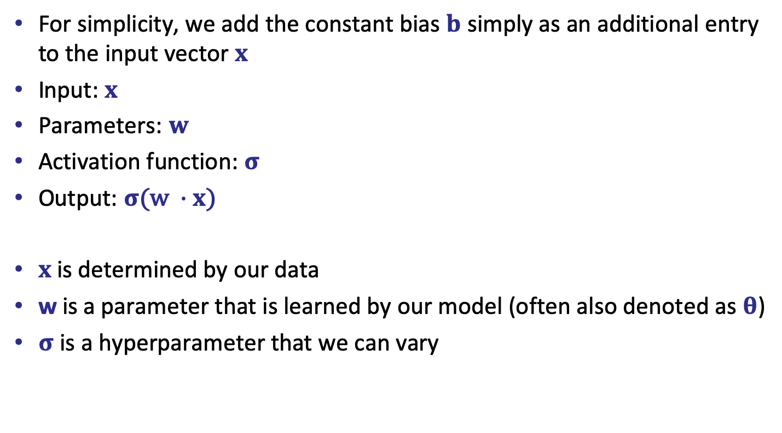
Formally
For simplicity, we add the constant bias $b$ simply as an additional entry to the input vector $x$
Input: $x$
Parameters: $w$
Activation function: $σ$
Output: $σ\text{(}\text{w} ∙x\text{)}$
$x$is determined by our data
w is a parameter that is learned by our model (often also denoted as $θ$)
$σ$ is a hyperparameter that we can vary

Slide 29
Activation function
The activation function is crucial.
Given the cumulated weighted input, it computes the output.
In a binary function: “firing or not firing”

Slide 30
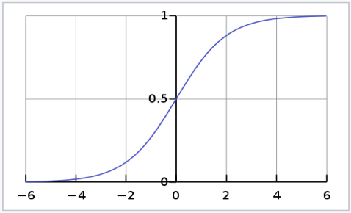
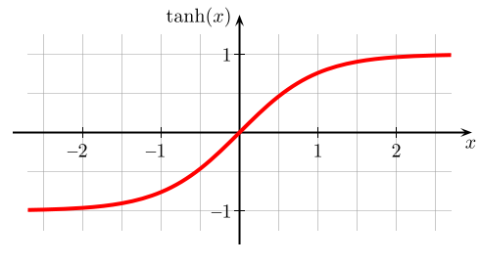
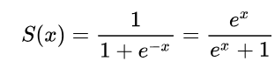
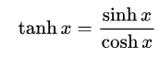
Sigmoid & Tanh
Sigmoid function (scale: 0 to 1)
Hyperbolic tangent (scale: -1 to 1)
https://en.wikipedia.org/wiki/Sigmoid_function
https://de.wikipedia.org/wiki/Tangens_hyperbolicus_und_Kotangens_hyperbolicus

Slide 31
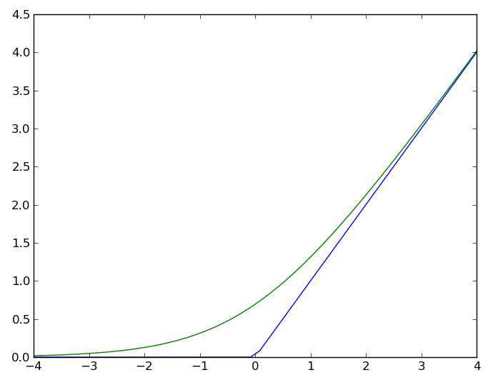
Rectified linear units (ReLu)
Rectifier (blue): f(x) = max(0,x)
Smooth approximation (green): f(x) = ln(1 + e^{x})

Slide 32
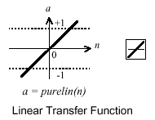
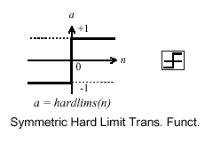
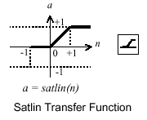
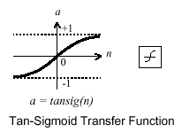
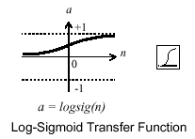
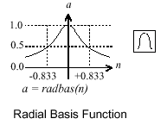
Many more…
Finding the ”best” activation function is still a question of tedious experimentation.

Slide 33
(Simple) Neural network
positive
negative
neutral
1
0
0
The
movie
was awesome
0
1
0
0
0
1
Notes:
1-hot representation oder Wahrscheinlichkeit

Slide 34
Live demo
Play around with different network architectures at Tensorflow Playground
Start with a linearly separable dataset, a linear activation function and no hidden layers.

Slide 35
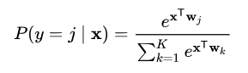
Softmax function
For the last output layer, we often want to receive a probability distribution over the classes as output.
To achieve this, we use the softmax as activation function for the last layer.
Activation for current label normalized by cumulated activation for all labels
→ global activation function
Notes:
Erinnern Sie sich: den softmax haben wir letzte Woche schon gesehen.
Interessant: das ist jetzt eine globale Aktivierungsfunktion, die die Werte von anderen Neuronen berücksichtigt. Alle anderen waren nur lokal, d.h. Output lediglich abhängig von Input * Weight und Aktivierungsfunktion
Umsetzung im Hirn schwer vorstellbar.

Slide 36
More complex neural network
Multiple hidden layers (multilayer perceptron)
The output of the previous layer serves as the input of the next layer. → forward propagation
Many more parameters and choices.
$$τ$$
$${ σ}_{ }$$
$$ψ$$
$$τ$$
$$x$$
$$W^{(1)}$$
$$n×h_{1}$$
$${ σ}_{ }$$
$$W^{(2)}$$
$$h_{1}×h_{2}$$
$$W^{(3)}$$
$$h_{2}×m$$
$$ψ$$
$$τ$$
$${ σ}_{ }$$
$$τ$$
Notes:
Unterschiedliche Aktivierungsfunktionen möglich
Unterschiedliche Gewichtsmatrizen

Slide 37
Feed-forward networks
In feed-forward networks the information flows only from left to right.
The error flows backwards.
There is no information exchange between neurons on the same layer.
$$τ$$
$${ σ}_{ }$$
$$ψ$$
$$τ$$
$$x$$
$$W^{(1)}$$
$$n×h_{1}$$
$${ σ}_{ }$$
$$W^{(2)}$$
$$h_{1}×h_{2}$$
$$W^{(3)}$$
$$h_{2}×m$$
$$ψ$$
$$τ$$
$${ σ}_{ }$$
$$τ$$
Notes:
Unterschiedliche Aktivierungsfunktionen möglich
Unterschiedliche Gewichtsmatrizen

Slide 38
How do we evaluate the result?
Similar to other machine learning models:
x is the input, f is our model (network structure), $θ$ are the parameters that need to be optimized (weights), t is the true output value in the training data T.
$\sum_{\left(x,t\right)∈T}{{\left(t−f_{θ}\left(x\right)\right)}^{2} }$
This is called the square loss for each predicted y: $ℓ\left(t,y\right)={\left(t−y\right)}^{2}$
If y and t are vectors → multi-dimensional square loss :
$$ℓ\left(t,y\right)= {\left|\left|t −y\right|\right|}^{2}$$

Slide 39
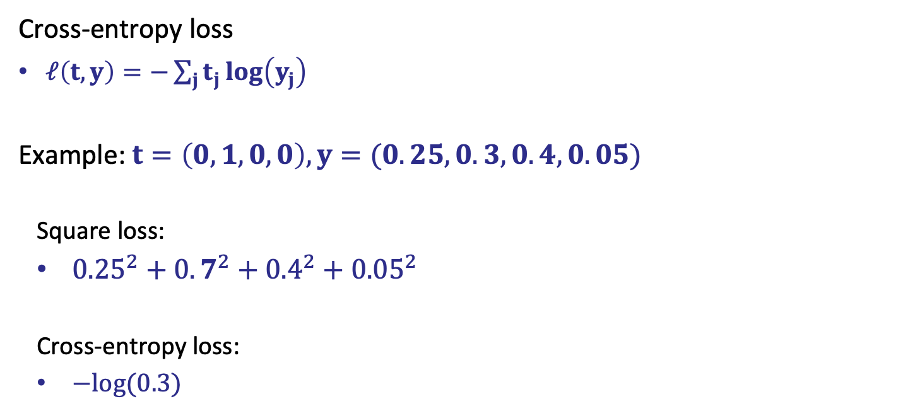
Common loss function
Cross-entropy loss
$ℓ\left(t,y\right)=−\sum_{j}{t_{j}\log\left(y_{j}\right)}$
Example: $t=\left(0,1,0,0\right), y=(0.25,0.3,0.4,0.05)$
Square loss:
${0.25}^{2}+{0.7}^{2}+{0.4}^{2}+{0.05}^{2}$
Cross-entropy loss:
$−log(0.3)$
Notes:
Ausrechnen?

Slide 40
How do we improve the loss?
Update the weights
→ Backpropagation
Repeat over many learning epochs

Slide 41
Backpropagation
Notes:
Beispiel für Business Analytics Studenten

Slide 42
Simplified backpropagation
Data: single instance x = 0.3, t = 0.7
Hyperparameter: activation function $σ$= tanh
squared loss: $\frac{1}{2} {(t−y)}^{2}$
Parameter: w, initialized at 0.25
y = tanh(0.25 ∗ 0.3) = 0.075
e = $\frac{1}{2}$ (0.7- 0.075)² = 0.195
Goal: Minimize the error!
$$w$$
$$σ\text{(}w\text{x}\text{)}$$
$$x$$
$$y$$
$$e$$
Notes:
GO back. Try again
½ ist nur dafür da, dass die Ableitung einfacher ist

Slide 43
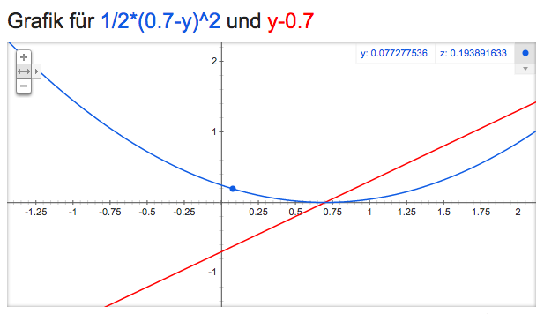
How do we minimize the error?
Minimize the loss function $f\left(y\right)= \frac{1}{2} {(t−y)}^{2}$
We can only modify y. How? Increase or decrease?
Lets look at the derivative f ’(y) = y - t.
f ’(0.075) is negative. To minimize e, go right. Increase y.
Notes:
Die Ableitung ist negativ. d.h. von links nach rechts gesehen, sind wir auf einer abschüssigen Strecke. Um weiter runter zu kommen, müssen wir y vergrößern.
An der Tafel:
½ * (t^2 - 2ty + y^2)
abgeleitet nach y: t^2 ist eine Konstante (+0.49) -> fällt weg 1/2 * (-2t + 2y) = -t + y

Slide 44
Propagate
How do we increase y?
$$w$$
$$σ\text{(}w\text{x}\text{)}$$
$$x$$
$$y$$
$$e$$
$$e$$
Notes:
GO back. Try again

Slide 45
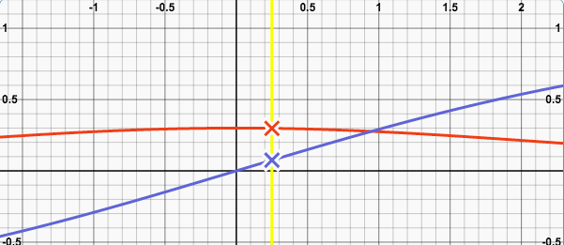
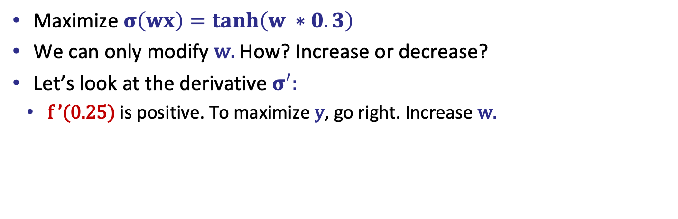
How do we increase y?
Maximize $σ\left(wx\right)=tanh\left(w ∗0.3\right)$
We can only modify w. How? Increase or decrease?
Let’s look at the derivative $σ^{′}:$
f ’(0.25) is positive. To maximize y, go right. Increase w.
Notes:
Achtung, hier maximieren wir!!!

Slide 46
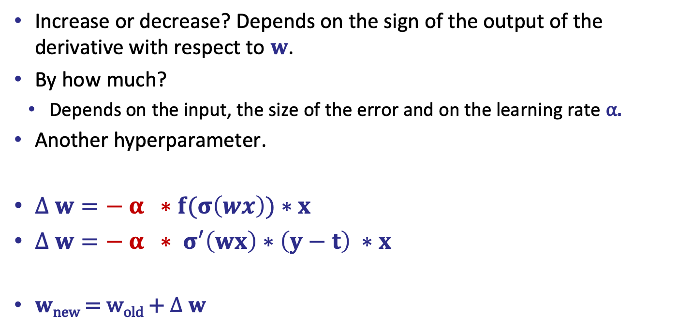
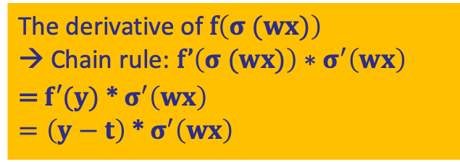
How do we update w?
Increase or decrease? Depends on the sign of the output of the derivative with respect to $w$.
By how much?
Depends on the input, the size of the error and on the learning rate α.
Another hyperparameter.
$∆ w=− α ∗f(σ\left(wx\right))∗x$
$∆ w={− α ∗ σ}^{′}\left(wx\right)∗\left(y−t\right) ∗x$
$w$_{new} = w_{old} + $∆ w$
The derivative of f$\left(σ (wx)\right)$ → Chain rule: f’$\left(σ (wx)\right)∗σ^{′}\left(wx\right)$
= $f′(y)$ * $σ^{′}\left(wx\right)$ $=\left(y−t\right)$ *$σ^{′}\left(wx\right)$
Notes:
Kettenregel: u’(v(x) * v’(x)

Slide 47
Splitting the error
$$\frac{w_{1}}{w_{1}+w_{2}}e$$
$x$₁
$$w_{1}$$
$$σ\text{(}w\text{x}\text{)}$$
$$y$$
$$w_{2}$$
$$e$$
$x$₂
$$\frac{w_{2}}{w_{1}+w_{2}}e$$
Notes:
In Abhängigkeit von der Größe des Gewichts Das habe ich in “Create your own neural network” gelesen, aber die meisten Backprop Algorithmen scheinen den Nenner wegzulassne und ich bin mir nicht sicher warum. Habe die Folie daher ausgeblendet.

Slide 48
Several outputs
Each output node has a different error. Only propagate the error back to the respective incoming edges.
$$e_{1}$$
y
1
$$x$$
0
0
Notes:
Weight sharing ist wichtig um die Anzahl der zu lernenden Parameter zu reduzieren

Slide 49
Several outputs
Sum all incoming errors.
y
$$e_{1}$$
$$e_{3}$$
$$e_{2}$$
1
$$x$$
0
0
Notes:
e3 ist null

Slide 50
Hidden layers
What is the error of a hidden node?
$∆ v =− α ∗\left.\text{φ}‘\text{(}\text{v} σ\text{(}w\text{x}\text{)}\right) ∗ \left(y−t\right)∗σ\text{(}w\text{x}\text{)}$
$∆ w={− α ∗ σ}^{′}\left(w\text{x}\text{)}\right)∗δ2∗x$
$δ2$: the error signal at layer 2
$δ1$: the error signal at layer 1
$$w$$
$$σ\text{(}w\text{x}\text{)}$$
$$v$$
$$\text{φ}\text{(}\text{v} σ\text{(}w\text{x}\text{)}\text{)}$$
$$x$$
$$y$$
$$e$$
$$e$$
$$e$$
$$layer 1$$
$$layer 2$$
Notes:
Ich bin mir nicht hundertprozentig sicher, dass das alles richtig ist.

Slide 51
Going multi-dimensional
x and y are vectors, several weight matrices W.
Instead of the derivative, we calculate the gradient → vector of partial derivatives
$∆ wij=− α \frac{∂ E}{∂wij}$
$$τ$$
$${ σ}_{ }$$
$$ψ$$
$$τ$$
$$x$$
$$W^{(1)}$$
$$n×h_{1}$$
$${ σ}_{ }$$
$$W^{(2)}$$
$$h_{1}×h_{2}$$
$$W^{(3)}$$
$$h_{2}×m$$
$$τ$$
$$ψ$$
$${ σ}_{ }$$
$$τ$$

Slide 52
Gradient descent
Minimize the error function by tuning the trainable parameters (weights)
Gradient of the error function indicates direction of update.

Slide 53
More than one training instance
Summing the derivative of the error function over all instances → too expensive
Update after a batch of instances. → Batch gradient descent or mini-batch gradient descent
Update after every instance → Stochastic gradient descent (SGD)
Notes:
Wichtig, was passiert wenn wir jedes Mal updaten: wildes hin und her springen

Slide 54
Stochastic gradient descent
Minimize the error function by tuning the trainable parameters (weights)
Gradient of the error function indicates direction of update.
We follow the gradient by a certain step length. This length is called the learning rate.
If the learning rate is too small, we end up in a local minimum.

Slide 55
Learning rate
Scales the gradient
→ speeds up or slows down learning
Too low: fall into local minimum
Too high: training might not converge (jumping back and forth)

Slide 56
Learning rate optimizations
Simple Idea: learning rate decay
→ decrease learning rate over time
Step decay: Reduce learning rate by some factor every few epochs
Exponential decay
1/t decay
…
Notes:
Falls Sie in GKI waren, erinnern Sie sich vielleicht an Simulated Annealing. Temperatur kühlt ab, Wahrscheinlichkeit einen Random Schritt zu machen sinkt
Ähnliche Idee: Am Anfang ruhig extremere Korrekturen der Weights (Übersteuerung um schneller in den richtigen Bereich zu kommen), später nur noch kleine.

Slide 57

Learning rate optimizations
More advanced optimizations
ADAGRAD
ADADELTA
RMSProp
Momentum
...
more wacky oprimizations of gradient descent:
http://sebastianruder.com/optimizing-gradient-descent/

Slide 58
How do we initialize the weights?
All zero → bad idea
Randomized → okay, but hard to optimize
Low random values: Problem of vanishing gradients During backpropagation, each of the weights receives an update proportional to the partial derivative of the error function. The problem is that in some cases, the gradient will be vanishingly small, effectively preventing the weight from changing its value.
High random values: Problem of exploding gradients
Notes:
wenn ich kleine Werte mit kleinen Werten multipliziere (propagation) bekomme ich noch kleinere Werte

Slide 59
How do we initialize the weights?
All zero → bad idea
Randomized → okay, but hard to optimize
Current state-of-the-art: Glorot initialization (or “Xavier” initialization)
$W_{ij}=U\left[−\frac{1}{\sqrt{n}}, +\frac{1}{\sqrt{n}}\right]$
U is the uniform distribution
n is the size of the previous layer (the number of columns of W)
Subject to a lot of experimentation
Xavier Glorot & YoshuaBengio. (2010): Understanding the difficulty of training deep feed forward neural networks http://proceedings.mlr.press/v9/glorot10a/glorot10a.pdf

Slide 60
Backpropagation

Slide 61
Regularization
Notes:
Beispiel für Business Analytics Studenten

Slide 62
Why regularization?

Slide 63
Why regularization?
Train a model to fit the data.
Notes:
MOdel the data

Slide 64
Why regularization?
Notes:
Also a good model, but the other one was better → avoid overfitting

Slide 65
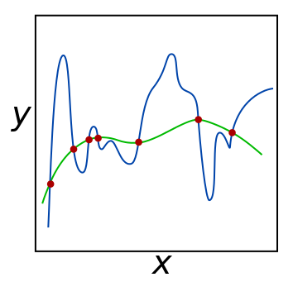
Regularization
From https://en.wikipedia.org/wiki/Regularization_(mathematics)

Slide 66
How can we apply regularization?
Our goal was to minimize the error function by optimizing the weights.
We want to avoid that the weights get too fitted to the data. → add a regularization term to the objective function
minimize: f(w) + $λR(w)$
$λ$ is our regularization parameter
R is our regularization function
L2 regularization: $R\left(w\right)={|\left|w\right||}^{2}=\sum_{i}{w_{i}^{2}}$
L1 regularization: $R\left(w\right)=\left|w\right|=\sum_{i}{|w_{i}|}$
If we want to minimize the whole thing, we need to minimize the error and the regularization function → keep the weights small
Notes:
wenn ich kleine Werte mit kleinen Werten multipliziere (propagation) bekomme ich noch kleinere Werte

Slide 67
Dropout
Notes:
Beispiel für Business Analytics Studenten

Slide 68
Dropout

